Slide 1
Lead Scoring Case Study
By
T Sai Kamal Chand
Sampath
Chandan Singh

Slide 2
Process Summary
Data Cleaning and Preparation
EDA
Dummy Variables
Dataset split into Train and Test
Feature Scaling
Model Building
Model Evaluation and Prediction on Test dataset
Precision – Recall
Conclusion and Findings

Slide 3
Data Cleaning and Preparation
There are 9240 rows and 37 columns.
Dropped the columns with NULL values that are more than 40% and some redundant variables with unique values of 1 and other variables where only one value is predominantly seen.
Changed the values with “Select” to NAs.
Data Visualization - EDA
Categorical and Numerical Variables
  Univariate Analysis
  Bivariate Analysis

Slide 4
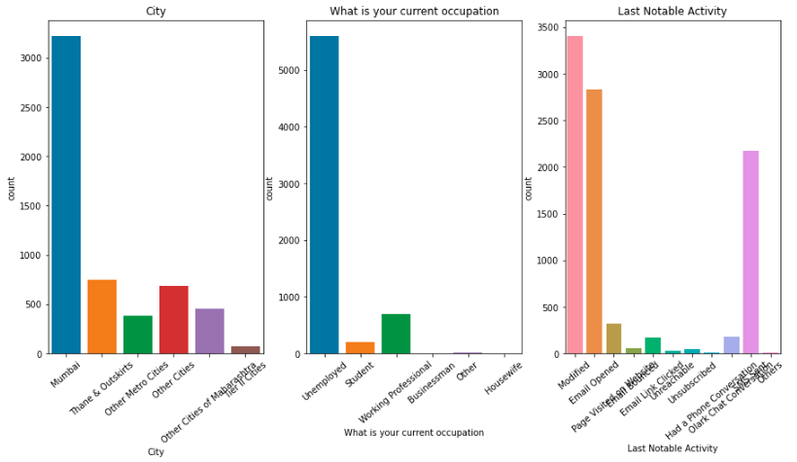
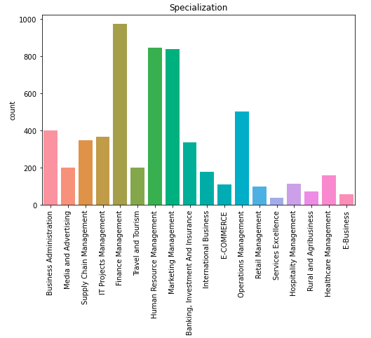
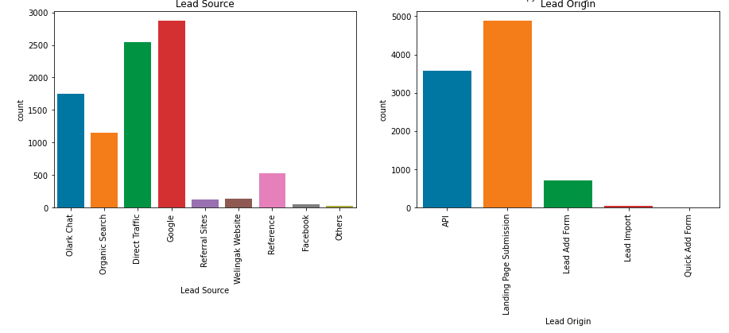
Univariate Analysis

Slide 5
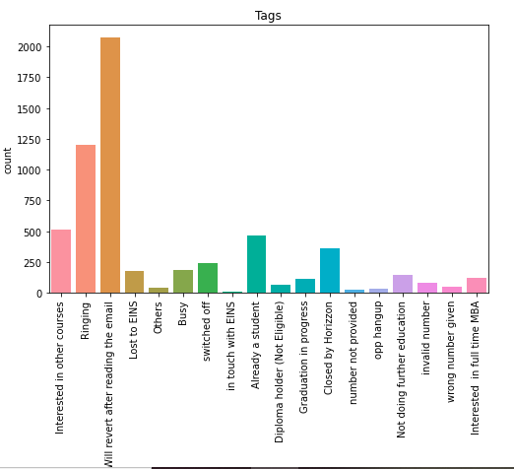
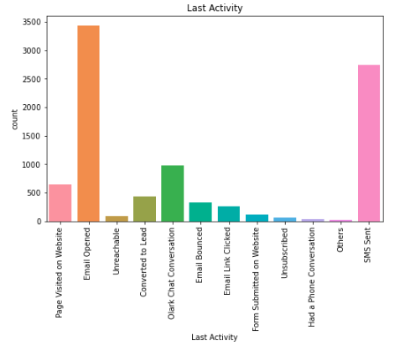
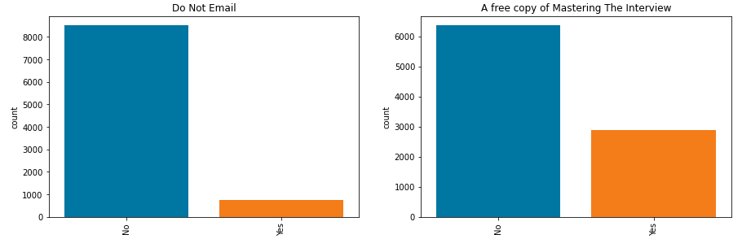

Slide 6
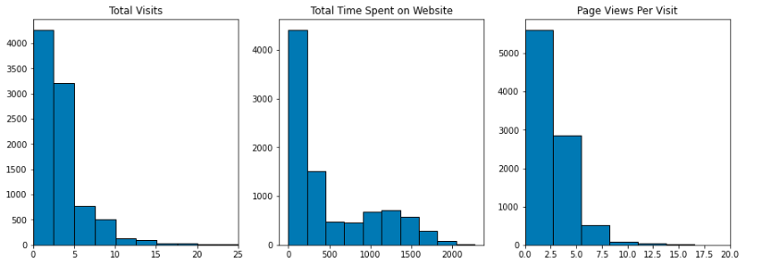
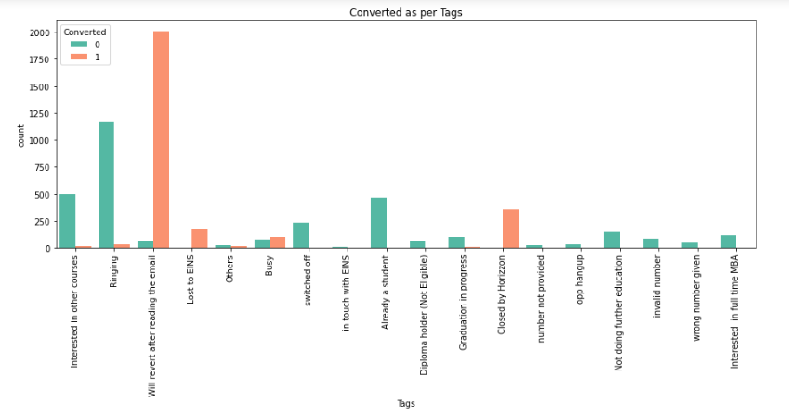
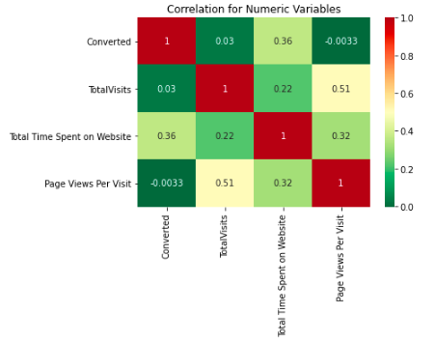
Bivariate Analysis and Correlation Matrix

Slide 7
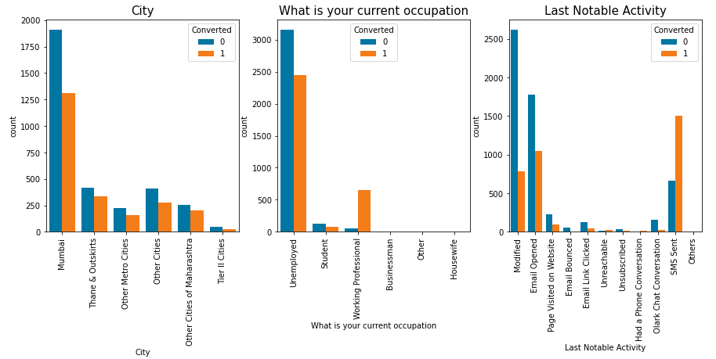
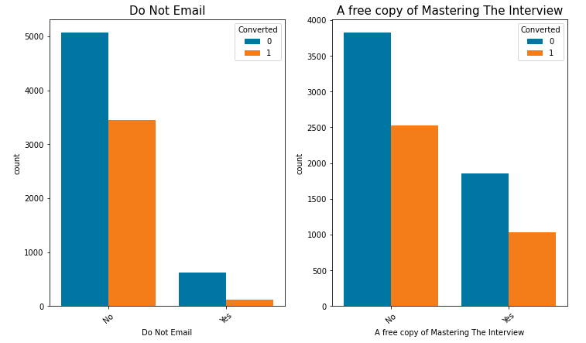
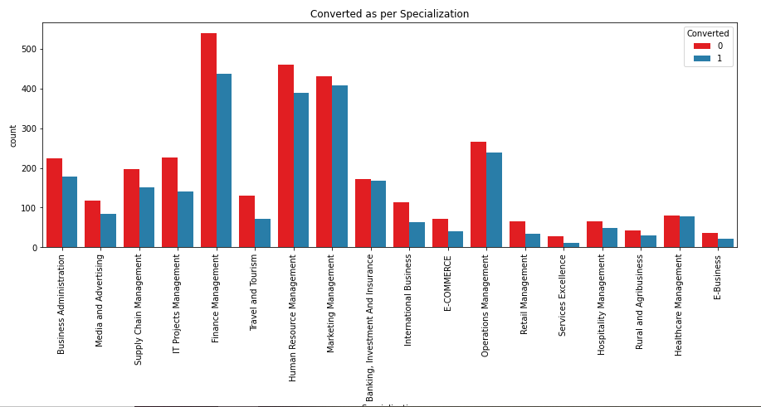
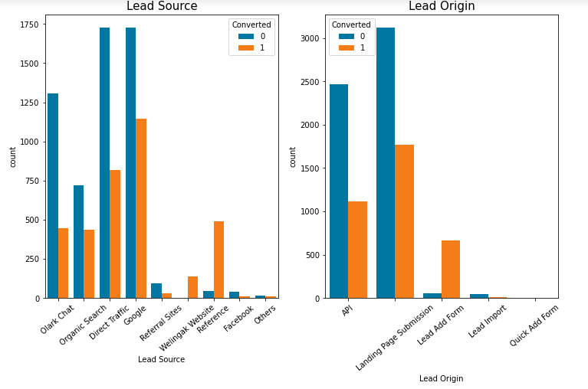

Slide 8
Dummy Variables
Created dummy variables for all categorical variables.
Dataset split into Train and Test
The dataset was split into 70% train and 30% test.
Missing value treatment was done for X train dataset.
Feature Scaling
Using MinMaxScaler, all the numeric variables were re-scaled.
Model Building
Using Recursive Feature Elimination (RFE) for selecting 15 top important features.
Built model with the variables which have VIF < 5 and p-value < 0.05.
Checked the optimal probabilities and the cutoff points on the train set.

Slide 9
Model Evaluation and Prediction on Test dataset
Area under ROC Curve is 0.96.
For the train dataset, with a 0.3 cutoff, Accuracy, Sensitivity, and Specificity 91%.
Predicted the test dataset with Accuracy (91%), Sensitivity (92.5%), and Specificity (91%).
Precision – Recall
With cutoff 0.41,
  Accuracy - 91.9%, sensitivity - 89.2% and specificity - 93.5% on the train dataset.
  Accuracy - 91.6%, sensitivity - 90.4% and specificity - 92.4% on the test dataset.
  And, precision is 88%, and recall is 90% on the test dataset.

Slide 10
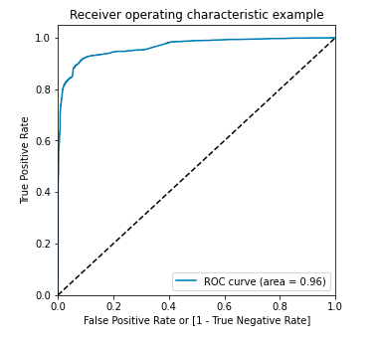
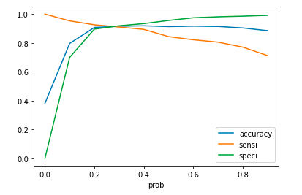
ROC Curve and Optimal Probabilities

Slide 11
Conclusion and Findings
The lead score on the test dataset - 90.41%.
Features with high probability of a lead getting converted are:
  Tags_Closed by Horizzon
  Tags_Lost to EINS
  Lead Source_Welingak Website
  Tags_Will revert after reading the email.
  Last Activity_SMS Sent
Negatively affected variables to avoid. Some of them are
  Tags_Ringing
  Tags_switched off
  Tags_invalid number

